Slide 1

ICT 1404 –Mathematics & Statistics
for Computing
Probability
P.D.Wimalasiri
[(B.Sc. Maths, M.Sc. In Computer Sc., Sp. Trained in CICC Japan, Dip in Engineering OUSL )]
Academic and Social experiences in Singapore, Malaysia, Thailand, India, Japan
Lecturer in Computer Science/Mathematics
Rajarata University of Sri Lanka

Slide 2
The probability of an event is the chance or likelihood of the occurring an event.
If A is an event the Probability is denoted by P(A)
0 ≤ P(A) ≤ 1

Slide 3
Axioms of Probability
The probability of each outcome is greater than or equal to zero. 0≤P(A)
The probability of a certain or sure event is one. P(A)=1
The probability of an impossible event is zero. P(A)=0
Therefore, the probability of an uncertain event is always between zero and one.
0 ≤ P(A) ≤ 1

Slide 4
Examples:
Getting ‘Head’ when a coin is tossed
Obtaining 5% of defected items out of all items
Occurring an accident at a specific place of a road
Completing the construction of Hostel building
Receiving an order of goods on time.
Sun rises at tomorrow
Awarding a First Class in your Degree.

Slide 5
Methods of Approach to probability
1. Classical Approach
2. Relative Frequency Approach
3. Personalistic Approach
4. Mathematical approach

Slide 6
1. Classical Approach
In classical approach each and every events are considered as having equal chance to happen (equally likely events).
P(A)=n(A)/n(S)
example1: Getting ‘head ‘ when a coin is tossed.
Getting ‘head ‘ - H
Getting ‘tail‘ - T
Pr(H)=n(H)/n(S)
Pr(H)=1/2
S={ H, T } n(S)=2 n(H)=1

Slide 7
Example 2: Getting sum of the values is ten when two dies are thrown.
4
9
S= { (1,1),(1,2),…..,(1,6),(2,1),(2,2),…………(6,1),……(6,6)}
A= { (4,6),(5,5),(6,4)}
n(S)=36 n(A)=3
Pr(A)=3/36 = 1/12

Slide 8
1. Relative frequency Approach
If outcomes are not with equal chances then classical approch cannot be used. Then it is used Relative frequency Approach.
In this approach number the occurrences of the event is divided by total number of times random experiment done.
number of times event occured
Probability=
Total Number of time experiment done

Slide 9
Example: Tossing a coin
No. of times experiment done | No. of times getting Head | P(A)
10 | 4 | 0.4
100 | 38 | 0.38
1,000 | 381 | 0.381
10,000 | 3805 | 0.3805
100,000 | 38015 | 0.38015
Higher the number of times experiment done higher accuracy of probability.
Therefore P(A)=0.38

Slide 10
Random Experiment
A process which generate outcomes with uncertainty.
Examples:
Tossing a coin
Throwing a die
Getting a card from a card pack
Sample space
The set of all possible outcomes within the random experiment.

Slide 11
Sample space can be represent in following ways.
Sets
Tree diagrams
Graphical method
Example:
Tossing a fair coin
S= {HH,HT,TH,TT}
T
x
x
H
x
x
H
H
H
T
T
H
T
T

Slide 12
event space
Collection of possible outcomes relevant to the given event
Example:
The event which gives a sum of ten when two dice are thrown.
Sample space = { (1,1),(1,2),…..,(1,6),(2,1),(2,2),…………(6,1),……(6,6)}
Event space= { (4,6),(5,5),(6,4)}

Slide 14
Mutually Exclusive Events
When two or more events (call them "A" and "B") are Mutually Exclusive if it is impossible for them to happen together.
Example: Getting value 2 and 5 if a die is thrown

Slide 15
……Mutually Exclusive Events
Example:2 :
A : Getting an odd number when a die is thrown
B : Getting an even number when a die is thrown
Therefore A & B are Mutually Exclusive Events
But Getting an odd number event and getting number 5 are not mutually exclusive.
Mutually exclusive events shown by using Venn diagram
A
B

Slide 16
..... Mutually Exclusive Events
Addition Rule for Mutually Exclusive Events
If A and B are two mutually exclusive events
P(A or B) =P(A)+P(B)
If A₁, A₂, ….. A_{n} are n mutually exclusive events
P(A₁ or A₂ or ….. or A_{n}) =P(A₁)+P(A₁)…….+P(A_{n})

Slide 17
If A and B are not mutually exclusive events
P(A or B) =P(A)+P(B)- P(A∩B)
If A , B and C are not mutually exclusive events
P(A or B or C) =P(A)+P(B)+P(C)- P(A∩B)- P(B∩C)-P(C∩A)+P(A∩B ∩C)

Slide 18
Independent events
Definition
Two events, A and B, are independent if the fact that A occurs does not affect the probability of occurring B.
Example:1 :
P – A student getting an A pass from a test
Q – Another student getting an A pass from the test

Slide 19
..... Independent events
Multiplication Rule:
When two events, A and B, are independent, the probability of both occurring is:
P(A and B) = P(A) · P(B)
If events, A₁, A₂, ….. A_{n} are independent each other the probability of all occurring together is:
P(A₁ and A₂ and ….. and A_{n}) =P(A₁)P(A₁)…….P(A_{n})

Slide 20

Example 1:
A jar contains 3 red, 5 green, 2 blue and 6 yellow marbles. A marble is chosen at random from the jar. After replacing it, a second marble is chosen. What is the probability of choosing a green and then a yellow marble?
P(green) | = | 5
 |  | 16
P(yellow) | = | 6
 |  | 16
P(green & yellow) | =
5 | · | 6
16 |  | 16

Slide 21
Example2:
Urn A contains 5 red marbles, 3 green marbles and 8 blue marbles. Urn B contains 3 red marbles and 5 white marbles. An urn is randomly chosen and a marble is selected randomly. Find the probability that a red marble is chosen.
8/16
Blue
A
5/16
A
B
1/2
Red
3/16
Green
1/2 x 5/16 = 5/32
1/2
3/8
Using multiplication law of probability
B
Red
5/8
Green
1/2 x 3/8 =3/16
Using addition law of probability, the answer is = 5/32 + 3/16
= 11/32

Slide 22
Example
A student expect that she will obtain grade A passes for subjects statistics and mathematics with probabilities 90% and 70% respectively. Consider that obtaining A passes are independent. Find the probabilities that she will obtain,
(i) A passes in both subjects,
(ii) at least in one subject.

Slide 23
Solution
i) A - obtaining an A pass in Statistics
B - obtaining an A pass in Mathematics
P(A) = 0.9 P(B) =0.7
obtaining A passes in both subjects = P(A∩B)
since events are independent, P(A∩B)= P(A).P(B)
= 0.9 x 0.7 = 0.63
ii) A’ - not obtaining a A pass in subject Statistics
B’ - not obtaining a A pass in subject mathematics
P(A’) = 1-0.9 = 0.1
P(B’) =1-0.7 = 0.3
The probability that obtaining A pass at least in one subject = 1-P(A’∩B’)
= 1-0.03= 0.97

Slide 24
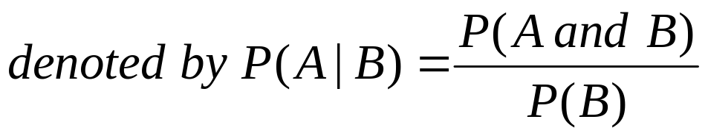
Conditional Probability
The conditional probability of event A given event B,
provided P(B) >0

Slide 25
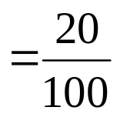


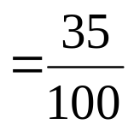
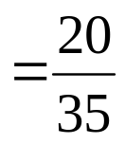

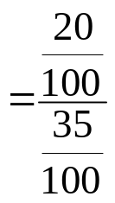
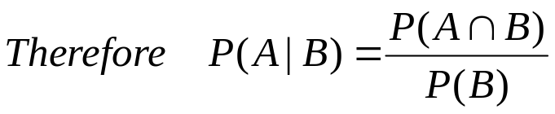
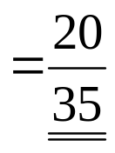
Example 1:
Find the probability that a randomly selected employee being a married male employee given that he is a male employee for following information.
 | Male employees, B | Female employees B’
Married employees, A | 20 | 35 | 55
Unmarried employees, A’ | 15 | 30 | 40
 | 35 | 65 | 100
Solution
P(be an employee Married and Male) =
P(be a Male employee) =
P(given that Male employee be a Married employee)

Slide 26


 | Male employees, B | Female employees B’
Married employees, A | 20 | 35 | 60
Unmarried employees, A’ | 15 | 30 | 40
 | 35 | 65 | 100
P(given that Male employee be a Married employee)
, P(A|B)

Slide 27
Example 2:
A flight has a 0.9 probability of departure on time from Colombo airport and a 0.8 probability of arrival on time to Singapore airport. The probability a flight which depart on time from Colombo and arrival on time to Singapore is 0.75. Find
The probability of arrival which was depart on time from Colombo
The probability of depart which was arrived on time to Singapore

Slide 28
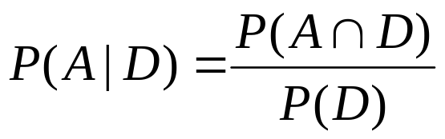
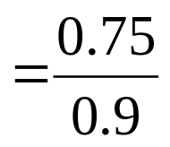
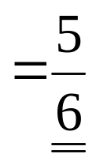
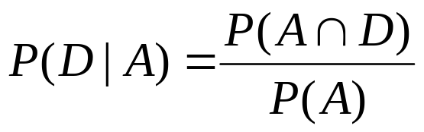
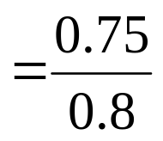
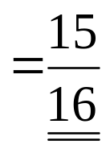
Solution
D – Depart from Colombo on time
A – Arrival at on time to Singapore
P(D) = 0.9
P(A) = 0.8
P(A∩B)= 0.75
A|D - The probability of arrival which was depart on time from Colombo
(ii) D|A – The probability of depart which was arrived on time to Singapore

Slide 29
Baye’s Theorem
A partition of a sample.
A1, A2 and are mutually exclusive and totally exhaustive.
A1
A2
A2
A3
An-1
A1, A2 ,A3….. An are mutually exclusive and totally exhaustive.
A1
Ai
An

Slide 30

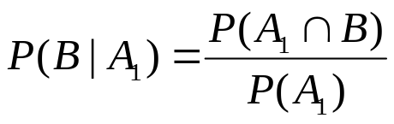


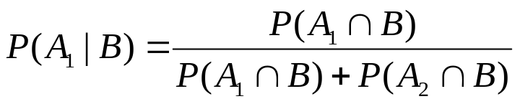
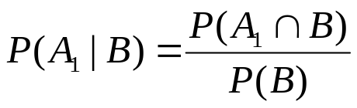
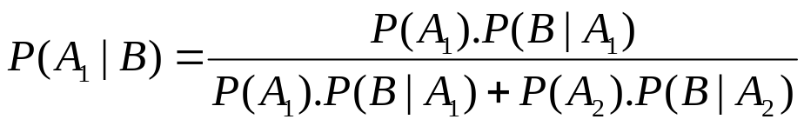
Baye’s Theorem
A partition of the sample space is a collection of disjoint events A1, A2 whose union is S, the sample space.
A2
B
A1
A1∩B
A2∩B
A1∩B and A2∩B are mutually exclusive.

Slide 31
Example 1:
A student travels to school by bus or train only. Out of his travels 60% is travelled by bus and 40% is travelled by train. It has found that if he travels by bus the probability of late attendance is 2% and that for by train is 4%.
Find the probability that he delays attend school.
Find the probability that he would have come by bus if it is known that he is late

Slide 32
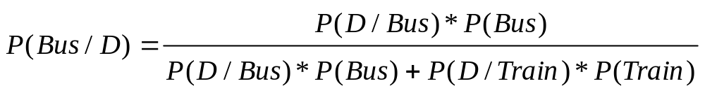
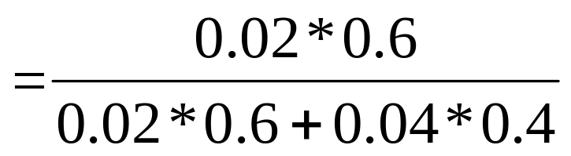
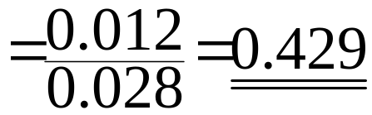
(i) Let D be the event of delay of the student.
P(D) = P(D|Bus)*P(Bus)+ P(D|Train)*P(Train)
= 0.02x0.6+0.04x0.4=0.028
(ii) Let D be the event of delay of the student.
P(Bus) = 0.6 P(Train) = 0.4
P(D|Bus) = 0.02 P(D| Train) = 0.04

Slide 33
Bayes’ Theorem …….
Example 2:
    Three machines A,B, and C produce, respectively, 40 percent, 10 percent, and 50 percent of the items in a factory. The percentage of defective items produced by the machines is, respectively, 2 percent, 3 percent, and 4 percent. An item from the factory is selected at random.
      Find the probability that the item is defective.
      If item is defective , find the probability that the item was produced by:
        (i) machine A, (ii) machine B, (iii) machine C.

Slide 34
Probability distributions
a probability distribution is a representation of random variable values of occurrence of different possible outcomes in an experiment and their associated probabilities.
Example 1
Random variable X is used to denote the Number of getting Heads of a fair coin tossing once ("the experiment"), then the probability distribution of X would take the value 1/2 for X = 1 and x=0.
X | 0 | 1
P(x) | 1/2 | 1/2

Slide 35
Example 2
Random variable X is used to denote the value of the outcome getting of a fair die tossing once.
X | 1 | 2 | 3 | 4 | 5 | 6
P(x) | 1/6 | 1/6 | 1/6 | 1/6 | 1/6 | 1/6
Example 3
Random variable X is used to denote the number of heads of getting of a biased coin tossing thrice with probability of getting Head is 2/3.
1/3
1/3
1/3
2/3
X | 0 | 1 | 2 | 3
P(x) | 1/27 | 2/9 | 4/9 | 8/27
1/3
2/3
2/3
2/3
1/3
1/3
2/3
2/3
1/3
2/3

Slide 36

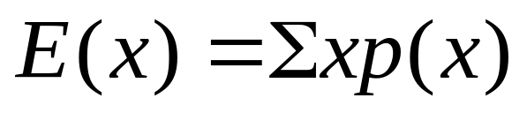


For any probability distribution
Expectation
Example 1
X | 1 | 2 | 3 | 4 | 5 | 6
P(x) | 1/6 | 1/6 | 1/6 | 1/6 | 1/6 | 1/6
Expectation is the mean of the probability distribution.
μ = E(x)

Slide 37
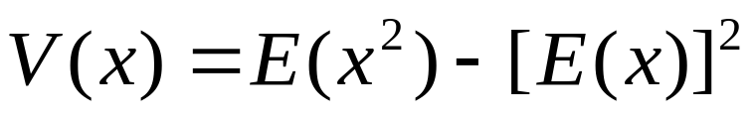
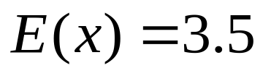


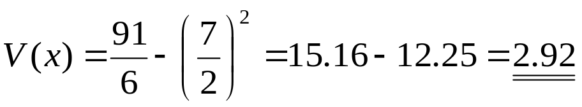
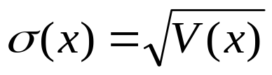
Variance
Example 1
X | 1 | 2 | 3 | 4 | 5 | 6
P(x) | 1/6 | 1/6 | 1/6 | 1/6 | 1/6 | 1/6
Standard deviation of the probability distribution

Slide 38
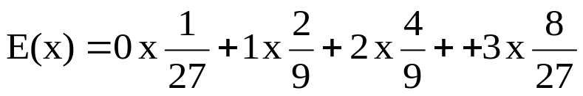
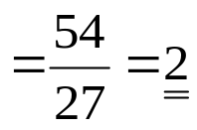
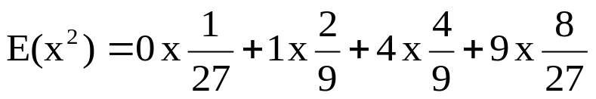
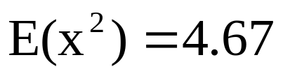

Find the probability distribution of the random variable X where X is the number of winnings of a game with 3 rounds with a probability of win is 2/3.Calculate the expectation and standard deviation.
Solution
X | 0 | 1 | 2 | 3
P(x) | 1/27 | 2/9 | 4/9 | 8/27

Slide 39
END

